Slide 1
Adeguatezza del sistema EMODnet alla creazione di prodotti e applicazioni per la società
Emergenze da sversamenti di oli combustibili in mare
Simona Simoncelli
e
Nadia Pinardi
INGV, Sezione di Bologna
Universita’ di Bologna
CMCC

Slide 2
Introduzione
EMODnet Sea Basin Checkpoints
Come nascono
Obiettivi
Challenges e Targeted Products
MedSea Checkpoint
Caso d’uso EMODnet per l’emergenze da sversamento di olio combustibile in mare
Valutazione degli esperti sul prodotto ottenuto

Slide 3
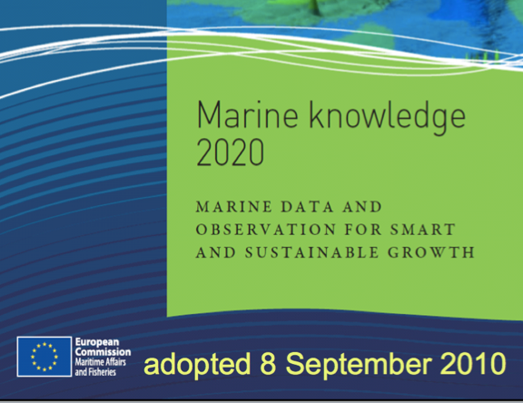
EMODnet Sea Basin Checkpoints
Green Paper Marine Knowledge 2020 →
limitata disponibilità e accessibilità ai dati marini nonostante le molteplici iniziative EU
visione approssimativa delle lacune e dei duplicati
nessuna visione d’insieme sulle priorità da attuare per la raccolta e l’assemblaggio dei dati marini
Rivoluzionare il sistema frammentato di gestione dei dati marini mediante una infrastruttura di condivisione interoperabile
Nuovo paradigma: si raccolga il dato per uno scopo preciso ma si riutilizzi più volte per altri scopi
Si ottimizzi la rete osservativa dimostrando come questa soddisfi I bisogni degli utenti sia del settore pubblico che privato (CHECKPOINTS!)
Notes:
The concept of Sea-Basin checkpoints was introduced within the Green Paper Marine Knowledge 2020:
→in spite of many EU initiatives (EMODnet, Copermicus) there are still shortcomings with the availability and accessibility of EU marine data → approximate overview of gaps and duplications and no overall view of priorites for further data collection or assembly
EMODnet Sea Basin Checkpoints assess the quality of the current observation monitoring data at the level of the regional sea-basins. By testing the data against specific end-user challenges, the checkpoints will demonstrate how well the current monitoring systems and data collection frameworks provides data to meet the needs of users. In doing so, data gaps and duplications as well as significant bottlenecks will be highlighted.
Six sea basin checkpoints are in operation. The first two checkpoints were initiated in the Mediterranean Sea and the North Sea in 2013; with checkpoints for the Arctic, Atlantic, Baltic and Black Sea being launched in 2015.
The concept of EMODnet Sea-Basin Checkpoints was introduced within the Green Paper 'Marine Knowledge 2020: from seabed mapping to ocean forecasting' (COM-2012-437). In spite of EU initiatives such as EMODnet, Copernicus and Data Collection Framework (DCF) for Fisheries to deliver seamless layers of marine data across national boundaries, there are still shortcomings with the availability and accessibility of EU marine data. Data collections have been largely put in place for specific and/or national purposes. There is still an approximate overview on a sea-basin scale of gaps and duplications and there is no overall view of what the priorities are for further data collection or assembly. Thus the EMODnet Checkpoint initiative will begin to link all existing monitoring data at the level of the Sea Basin and assess them in order to define their future improvements.

Slide 4
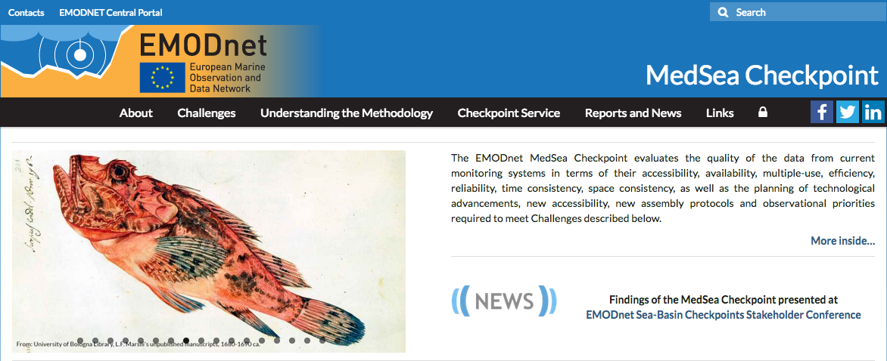
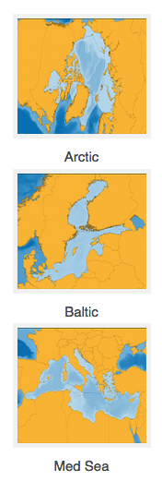
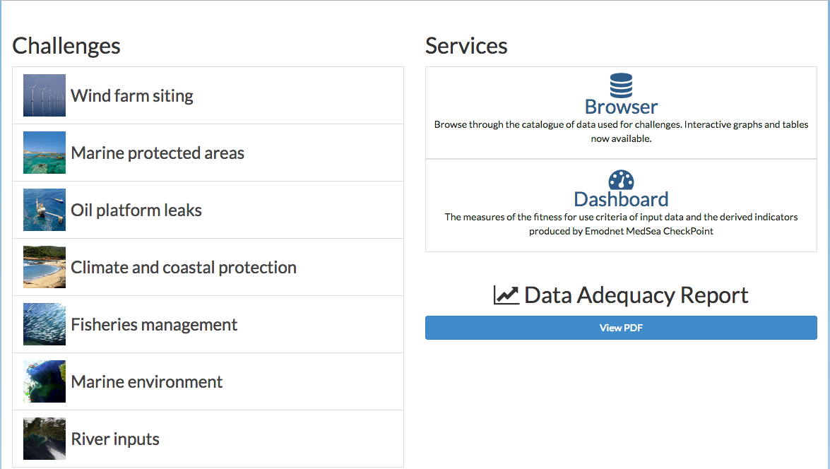
EMODnet Sea Basin Checkpoints
2015
2013
http://www.emodnet-mediterranean.eu/
Notes:
The concept of Sea-Basin checkpoints was introduced within the Green Paper Marine Knowledge 2020:
→in spite of many EU initiatives (EMODnet, Copermicus) there are still shortcomings with the availability and accessibility of EU marine data → approximate overview of gaps and duplications and no overall view of priorites for further data collection or assembly
EMODnet Sea Basin Checkpoints assess the quality of the current observation monitoring data at the level of the regional sea-basins. By testing the data against specific end-user challenges, the checkpoints will demonstrate how well the current monitoring systems and data collection frameworks provides data to meet the needs of users. In doing so, data gaps and duplications as well as significant bottlenecks will be highlighted.
Six sea basin checkpoints are in operation. The first two checkpoints were initiated in the Mediterranean Sea and the North Sea in 2013; with checkpoints for the Arctic, Atlantic, Baltic and Black Sea being launched in 2015.
The concept of EMODnet Sea-Basin Checkpoints was introduced within the Green Paper 'Marine Knowledge 2020: from seabed mapping to ocean forecasting' (COM-2012-437). In spite of EU initiatives such as EMODnet, Copernicus and Data Collection Framework (DCF) for Fisheries to deliver seamless layers of marine data across national boundaries, there are still shortcomings with the availability and accessibility of EU marine data. Data collections have been largely put in place for specific and/or national purposes. There is still an approximate overview on a sea-basin scale of gaps and duplications and there is no overall view of what the priorities are for further data collection or assembly. Thus the EMODnet Checkpoint initiative will begin to link all existing monitoring data at the level of the Sea Basin and assess them in order to define their future improvements.

Slide 5
Obiettivi
Valutare l’adeguatezza del sistema di monitoraggio e l’accessibilità dei dati a scala di bacino in base ad alcune applicazioni rilevanti per la società (Challenges) es. la capacità di prevedere in tempo reale, in caso di sversamenti di oli combustibili in mare, la loro dispersione e il loro possibile impatto sulla costa;
definire le priorità sui dati mancanti e di sviluppare strategie per sfruttare al massimo i dati esistenti
offrire raccomandazioni per sviluppare le capacità del sistema osservativo europeo
Notes:
EMODnet Sea Basin Checkpoints assess the quality of the current observation monitoring data at the level of the regional sea-basins. By testing the data against specific end-user challenges, the checkpoints will demonstrate how well the current monitoring systems and data collection frameworks provides data to meet the needs of users. In doing so, data gaps and duplications as well as significant bottlenecks will be highlighted.
Six sea basin checkpoints are in operation. The first two checkpoints were initiated in the Mediterranean Sea and the North Sea in 2013; with checkpoints for the Arctic, Atlantic, Baltic and Black Sea being launched in 2015.
The concept of EMODnet Sea-Basin Checkpoints was introduced within the Green Paper 'Marine Knowledge 2020: from seabed mapping to ocean forecasting' (COM-2012-437). In spite of EU initiatives such as EMODnet, Copernicus and Data Collection Framework (DCF) for Fisheries to deliver seamless layers of marine data across national boundaries, there are still shortcomings with the availability and accessibility of EU marine data. Data collections have been largely put in place for specific and/or national purposes. There is still an approximate overview on a sea-basin scale of gaps and duplications and there is no overall view of what the priorities are for further data collection or assembly. Thus the EMODnet Checkpoint initiative will begin to link all existing monitoring data at the level of the Sea Basin and assess them in order to define their future improvements.

Slide 6
Come ottimizzare il sistema di monitoraggio?
Challenges
Data collection programs
Data
Adequacy
Report
Wind farm siting
Copernicus
CKPT INDICATORS
MPAs
EMODnet TAGs
Oil platform leaks
INADEQUATE
PARTIALLY ADEQUATE TOTALLY ADEQUATE
Climate & Coasts
Fisheries Framework
Fishery management
National databases
Marine Environment
International DB
River inputs
Valutazione del sistema di monitoraggio mediante lo sviluppo di
Targeted Products
6/7/18
6

Slide 7
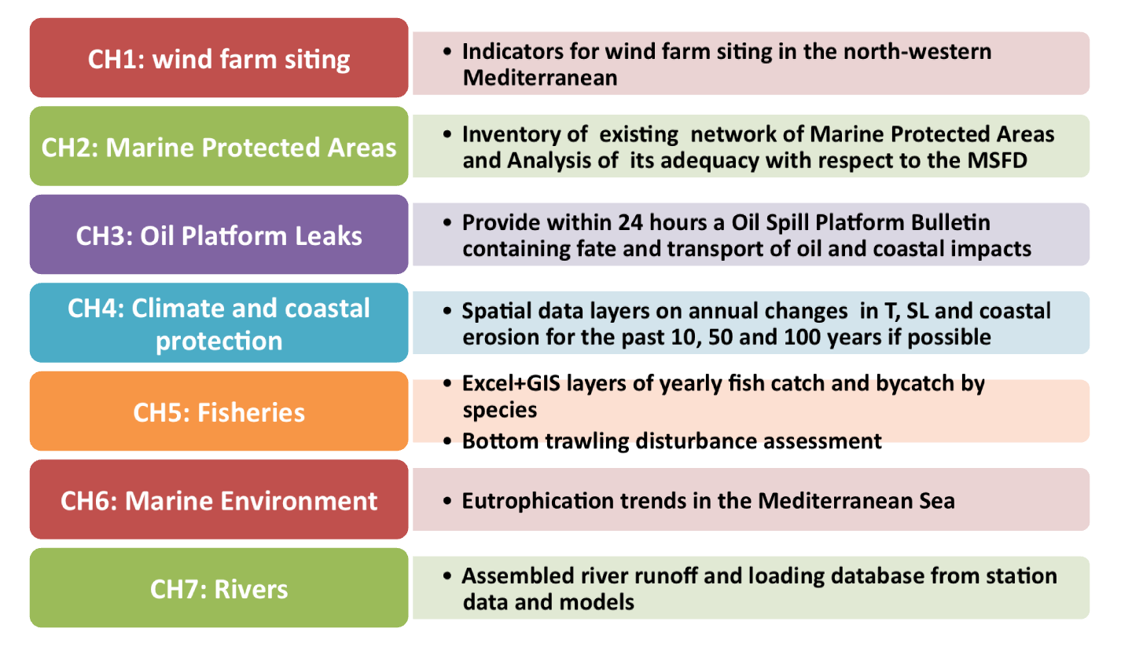
Challenges e Targeted Products

Slide 8
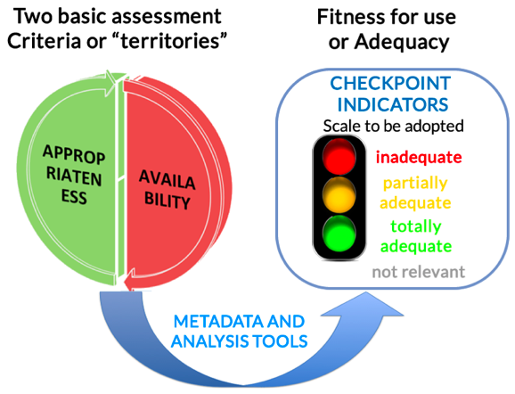
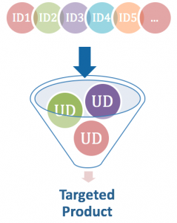
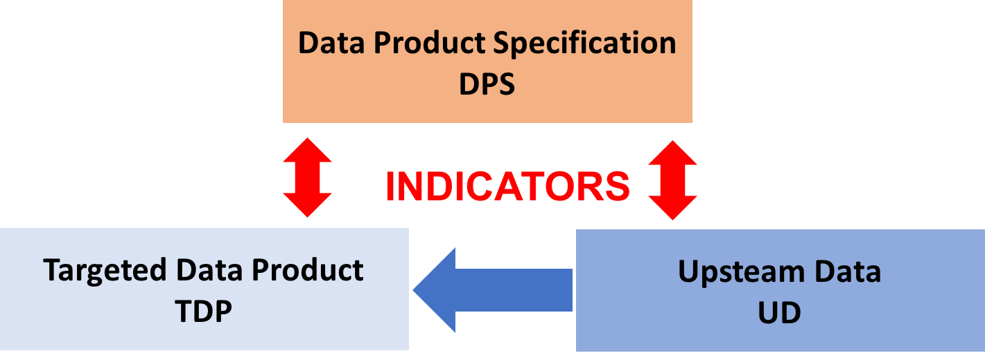
Indicatori
AVAILABILITY come gli input datasets sono disponibili
APPROPRIATENESS qual è la qualità degli upstream datasets utilizzati per generare i Challenge Targeted Products
La metodologia di basa su la :
input datasets e availability indicators
Data Product Specification (DPS)
Targeted Data Product (TDP) description
Upstream Data (UD) description
Notes:
Additional experts’ judgment on Targeted Products quality and usability according to the identified gaps in the upstream datasets → important verification of the implemented methodology and a unique critical approach to products evaluation.
Gaps of the monitoring system at the basin scales in view of the 7 prescribed Challenges emerged from the combined analysis of availability and appropriateness indicators.

Slide 9
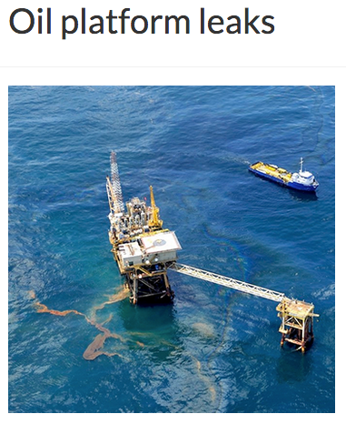
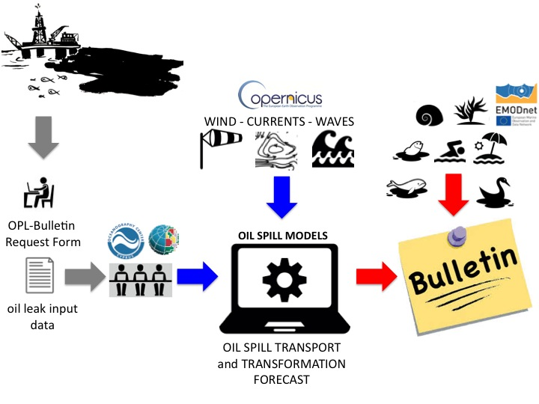
Challenge 3
Obiettivo: fornire rapidamente informazioni sulla dispersione di oli combustibili in mare e il loro possibile impatto sulla ambiente e le attività antropiche
Il rilascio del bollettino deve essere effettuato entro le 24 ora dalla comunicazione dell’incidente e fornire aggiornamenti giornalieri per i 5 giorni successivi
INPUT DATA
Oil platform position (lat, lon)
Date and time of the leak
Depth of the leak
Type of oil (API or oil type name)
Rate of leakage or tot oil leaked
Duration of leakage
Forecast simulation length

Slide 10
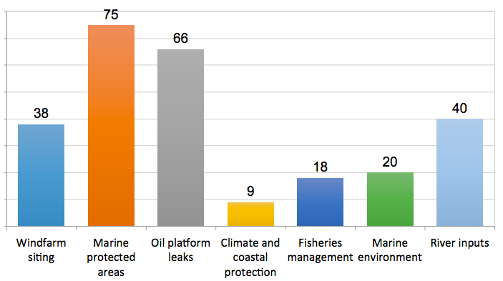
Input data
OPL-Bulletin si basa sulla disponibilità di previsioni e analisi meteo-oceanografiche ad alta risoluzione per il Mar Mediterraneo fornite da CMEMS (Copernicus Marine Environment Monitoring Service) o da altri sistemi di previsione nazionali:
venti
correnti
Onde
Dati aggiuntivi sono necessari per valutare l’impatto sull’ambiente e le attività umane
batimetria
Geomorfologia costiera
seabed substrate
Infrastrutture marine e costiere
Acquacultura
Aree marine protette
Rotte commerciali
Destinazione d’uso delle zone costiere
Input Dataset per Challenge

Slide 11
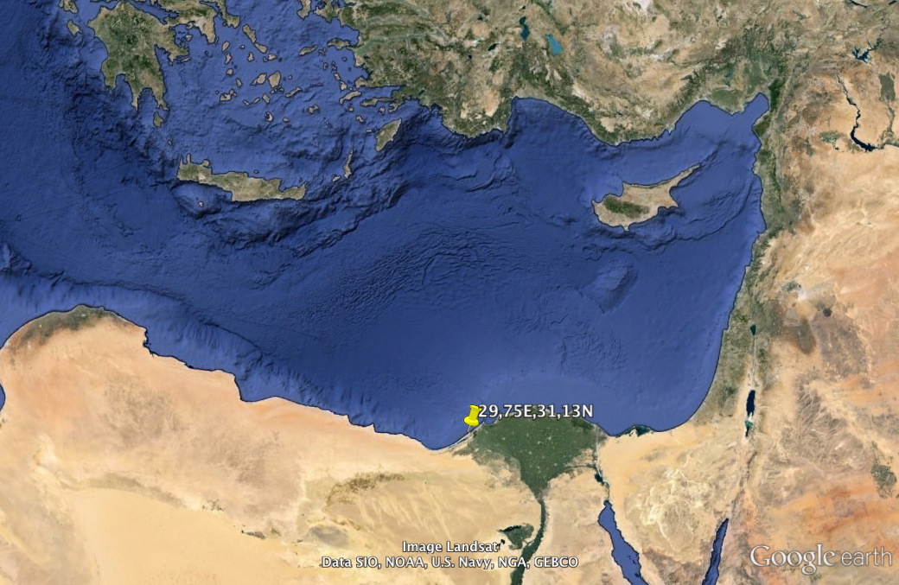
Stress Test
DGMARE Alert on May 10, 2016 at 11.23
"In August 2013 an incident occurred during a tanker loading operation at a buoy off the coast of the Sidi Kerir terminal of the Sumed pipeline (LAT: 31,130824N; LON: 29,75227E) with an estimated rate of 5000 m³ Brent crude oil spilled during a period of 24 hours starting 8:15 CET on 13/08/2013. The accident went largely unattended in the aftermath of the 2013 Egyptian Coup d’état during a period of unrest and instability."
INITIAL ASSUMPTIONS
OIL TYPE | Brent crude oil (API=38)
LEAK POSITION | LAT:31,130824 LON: 29,75227
TIME OF THE LEAK | 8:15 CET on 13/08/2013
DURATION OF SPILLAGE | 24 hours
RATE OF SPILLAGE | 177 Ton/hr
TOTAL AMOUT OF OIL SPILLED | 5000m3
SCENARIO | 1 | 2
Production Centre | INGV | OC-UCY
Oil spill model | MEDSLIK II | MEDSLIK
WIND | ECMWF | SKIRON
temporal resolution | 6 hours | 1 hour
spatial resolution | 25 km | 5 km
update frequency | daily | daily
CURRENTS and SST | CMEMS | CMEMS
temporal resolution | daily means | daily means
spatial resolution | 6.5 km | 6.5 km
update frequency | daily | daily
WAVES | - | CYCOFOS
temporal resolution | - | 3 hours
spatial resolution | - | 5 km
update frequency | - | daily

Slide 12
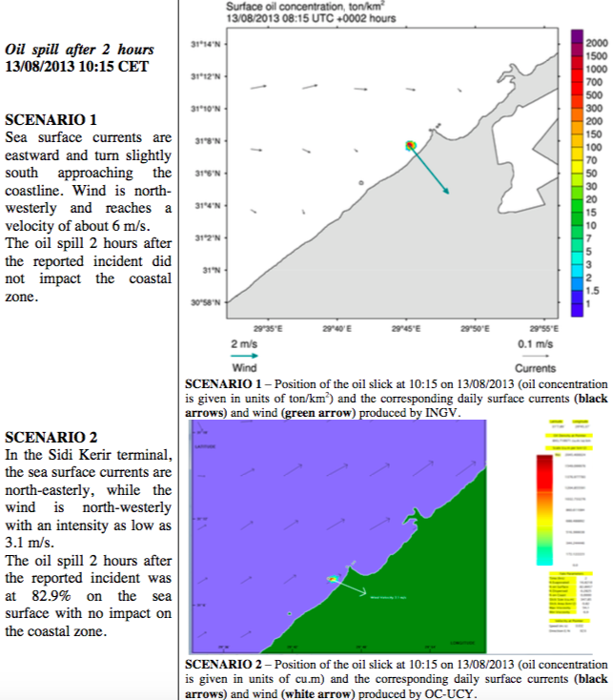
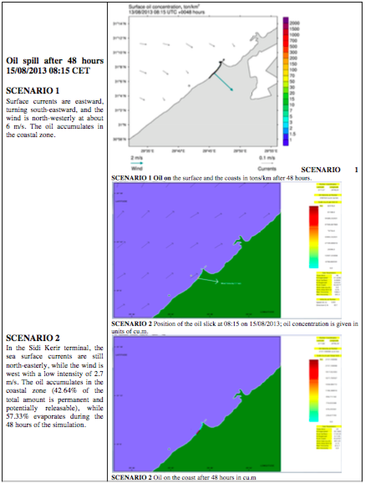
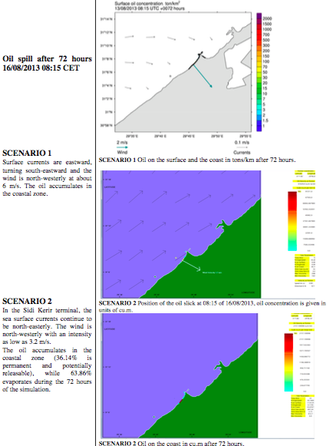
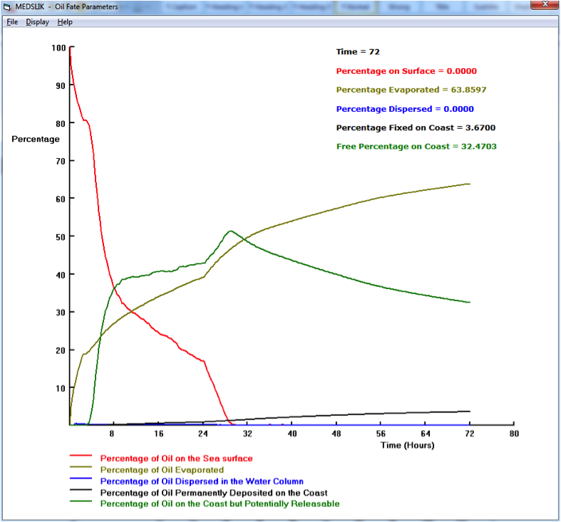
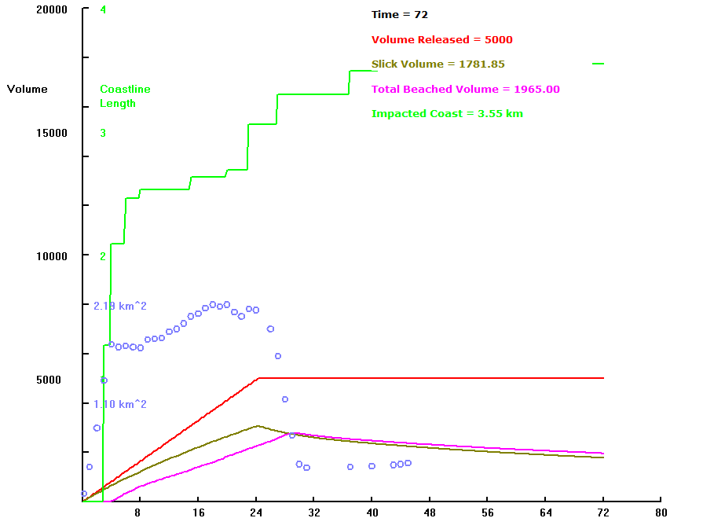
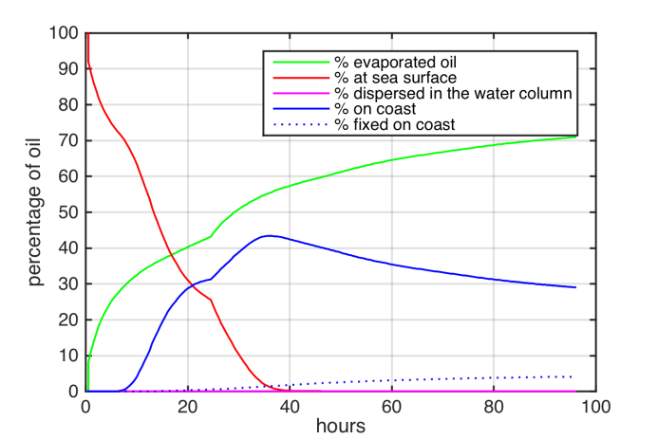
OPL Bulletin
Notes:
The results of both SCENARIOS show that after 30-40 hours almost all the released, non-evaporated oil (Figure 7 red line) arrived on the coast, mainly due to the persistent north-westerly winds and currents. The high percentage of free oil on the coast (potentially capable of returning to the sea) shown by both SCENARIOS indicates the possibility of prolonged and extended coastal impacts for up to 72 hours.
In SCENARIO 1, about 30% of the oil evaporated in the first 8 hours and more than 50% evaporated within 30 hours. In SCENARIO 2, 40% of the oil evaporated in the first 8 hours, increasing to 60% after 72 hours. The length of the coastal strip impacted by the oil leak is 3.55 km after 40 hours.

Slide 13
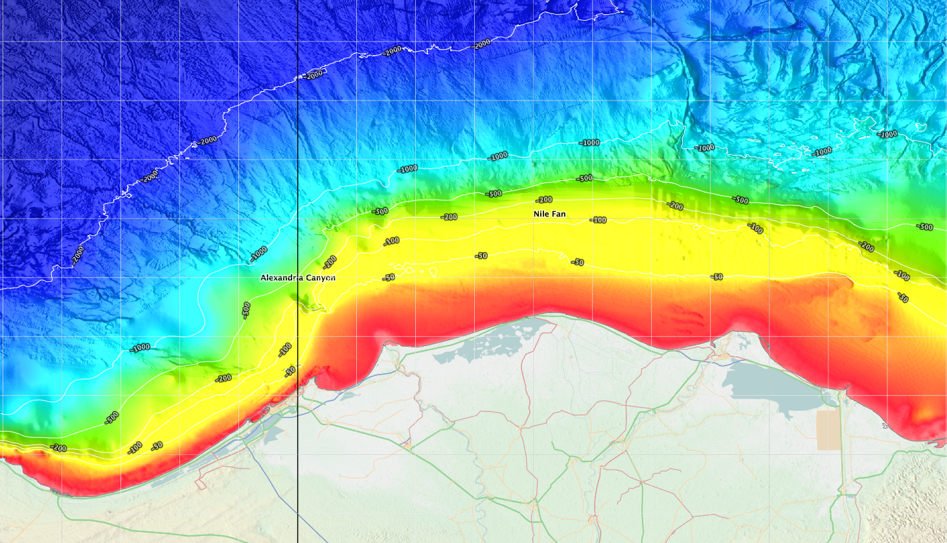
Valutazione dell’impatto
Bathymetry/elevation and coastal geomorphology
da EMODnet Bathymetry
The initial oil leak occurred on the continental shelf very close to the coast, which is influenced by the Nile river delta.
bathymetry of the incident area < 50 m

Slide 14
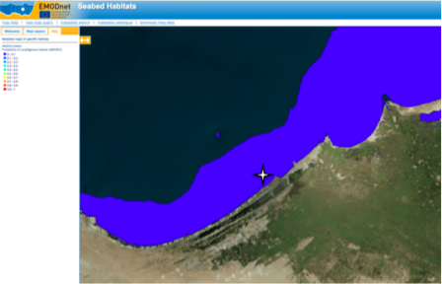
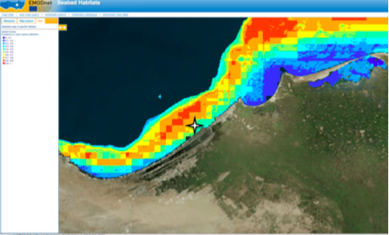
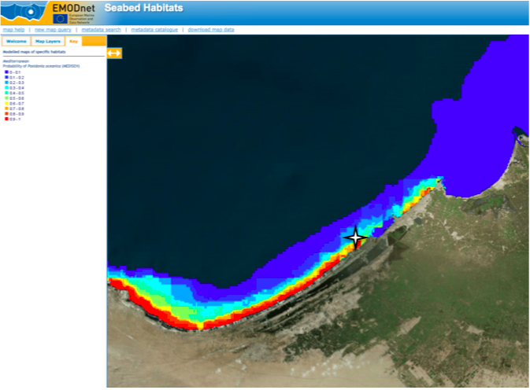
Valutazione dell’impatto
SeaBed Habitats from EMODnet Seabed Habitat →mappe di habitat specifici ottenute da modelli (MEDISEH EU Project)
probability of Coralligenous habitat
probability of maërl habitat (red coralline algae)
probability of coralligenous habitats <10% as it is a river influenced area.
50-90% probabilities of maërl habitats
50% probabilities of Posidonia Oceanica in the near-shore area
→ Gli effetti sugli habitat marini e l’ecosistema sarebbero disastrosi
probability of Posidonia Oceanica

Slide 15
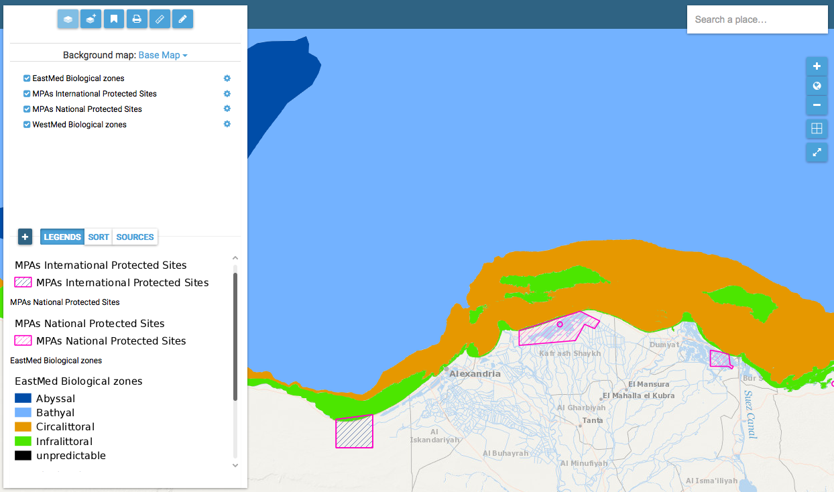
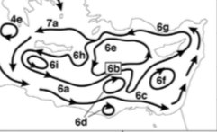
Valutazione dell’impatto
Marine Protected Areas and Biological zones
Information about Mediterranean protection initiatives (management and conservation areas), MPA extension areas, their protection levels and biological depth zones
Circalittoral and infralittoral biological zones would be highly damaged.
2 MPAs are located close to the spill zone. Considering the seasonal prevailing circulation in the impacted coastal area, both MPAs could be affected by damage to the coastal ecosystem.

Slide 16
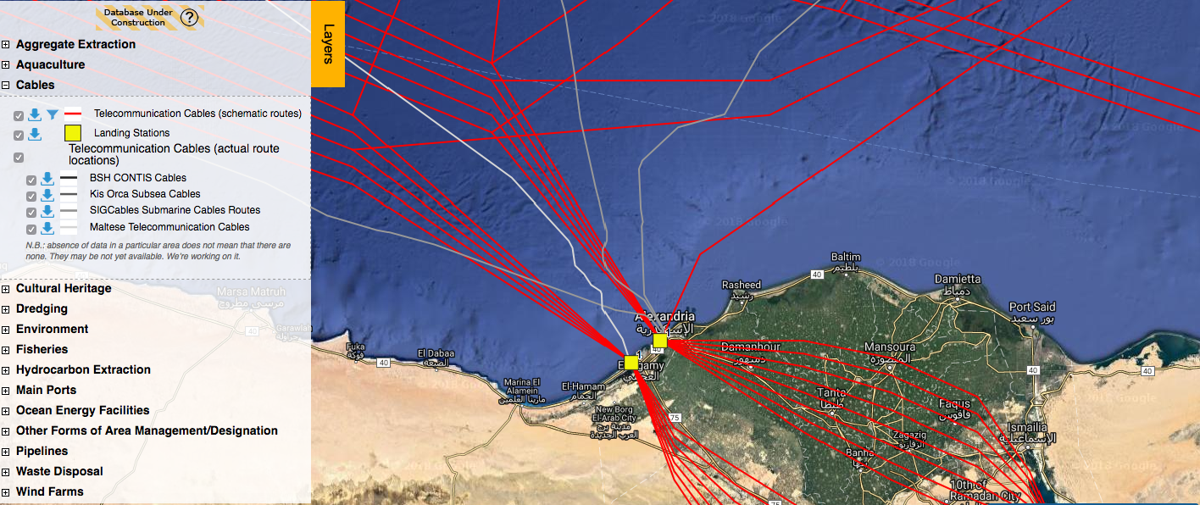
Valutazione dell’impatto
Transport route and use of coastal areas → gaps in the information along the African coast about human activities. The initial leak area is close to the entrance of Alexandria Harbour, the main port in Egypt. Alexandria is also considered the second most important city in Egypt and its coastal strip is densely populated. The economic impact of the incident on touristic and maritime transport activities must be estimated.

Slide 17
Valutazione degli esperti sul prodotto
La qualità in generale è molto buona nello stimare le conseguenze di uno sversamento di olio combustibile in una località prima sconosciuta, con i soli dettagli dell’incidente e nelle 24 ore successive all’incidente. La riproduzione di diversi scenari mostra il grado di incertezza legato a questo tipo di applicazioni
Le previsioni e le analisi meteo-marine disponibili grazie al servizio marino europeo Copernicus offrono una copertura complete del Mar Mediterraneo, ma la qualità del bollettino sarebbe migliore incrementando la risoluzione spazio temporale dei dati.
Copernicus è l’unico servizio che offre previsioni oceanografici pregressi per poter produrre simulazioni di sversamenti nel passato. Questi dati però, a differenza delle previsioni, sono disponibile solo su base giornaliera e non oraria, degradando la qualità della previsione (letteratura). I risultati non sono stati validati per la mancanza di osservazioni
La qualità della valutazione dell’impatto sull’ambiente e le attività antropiche è solo parziale in seguito ad una disomogenea copertura spaziale delle informazioni, che sono carenti nella regione meridionale del Mediterraneo

Slide 19
Assessment concepts
Universe of Discourse
view of the real or hypothetical world that includes everything of interest (ISO 19101)
Quality
How well a dataset represent the universe of discourse’ from a producer or a user perspective (ISO 19101)
World
WiND, WAVE, T, Depth, HABITAT EXTENT . . .
Producer
Universe of
discourse 1
(Targeted Products)
Universe of
discourse 2
(Input data sets)
User
Purpose
Use
Fitness for purpose
Fitness for use
Data production specifications
Quality evaluation
Quality
evaluation
Data selection requirements
selects
creates
Datasets
Notes:
‘Universe of Discourse’ defined as a ‘view of the real or hypothetical world that includes everything of interest’ (ISO 19101). The concept behind the quality of a dataset from a producer and a user point of view is shown in Figure 1.1.
In the CheckPoint case, the universe of discourse provides the model to assess the effectiveness of a monitoring system or data collection strategy, quality of data and quality of services that fits the user’s defined requirements, under specified operational conditions (represented by the Challenges).
Fitness for use is different from fitness for purpose: purpose describes the rationale for creating a dataset, while use describes the rationale for selecting a
dataset. The producer translates the purpose into production specifications, while the user translates his / her user requirements into selection specifications which may differ from the production specifications. The fitness for purpose is evaluated by the producer according to the specifications of the quality expected for his / her purpose. The fitness for use of a dataset is evaluated by the user according to the specifications of the quality expected for his / her use. The purpose of the CheckPoint is to provide an evaluation of the fitness for use of the datasets used by the Challenges.

