Slide 1
EMODnet ingestion: brokering of NRT hydrology data for integration in EMODnet physics portal
Enrico Boldrini
Paolo Mazzetti
Stefano Nativi
National Research Council of Italy, Institute on Atmospheric Pollution Research
CNR-IIA
enrico.boldrini@cnr.it

Slide 2
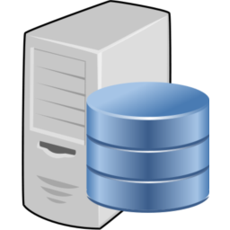
Hydrology sensor systems
rain
CUAHSI HIS/WML
FTP/CSV
SOS/WML
NHS
NHS
NHS

Slide 3
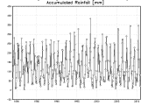
Federated architecture
CUAHSI HIS/WML
FTP/CSV
SOS/WML
NHS
NHS
NHS
HydroDesktop
Excel
52 North SWE

Slide 4
Brokering architecture
CUAHSI HIS/WML
FTP/CSV
SOS/WML
NHS
NHS
NHS
HydroDesktop
Excel
52 North SWE

Slide 5
Brokering architecture
CUAHSI HIS/WML
FTP/CSV
SOS/O&M
powering:
NHS
NHS
NHS
Takes care of mediation
of protocols and models
Enables interoperability
Cloud-based framework
GI-suite
Brokering Framework
HydroDesktop
Excel
52 North SWE

Slide 6
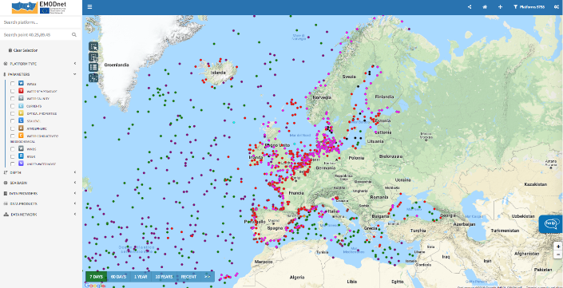
Brokering in EMODnet ingestion
Parameters:
discharge
precipitation
temperature
Area of interest:
Emilia Romagna region
Po river delta
CUAHSI WOF
GI-suite
Brokering Framework
OGC SOS
EMODnet Physics portal
Context: EMODnet ingestion (WP3 lead by ETT)
Near real-time (NRT) data (physical parameters) at in situ observatories

Slide 7
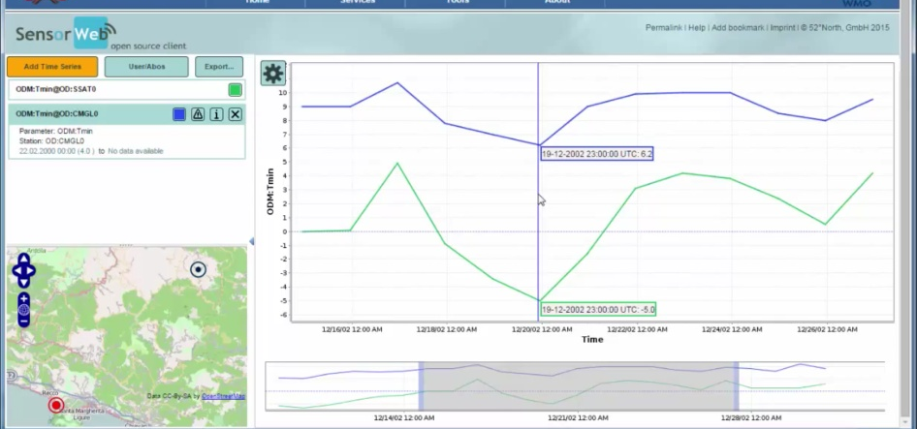
Data and information harmonization and interoperability
52North SWE client -> Broker -> Hydrology data
Protocol under test: OGC Sensor Observing Service v. 2.0

Slide 8
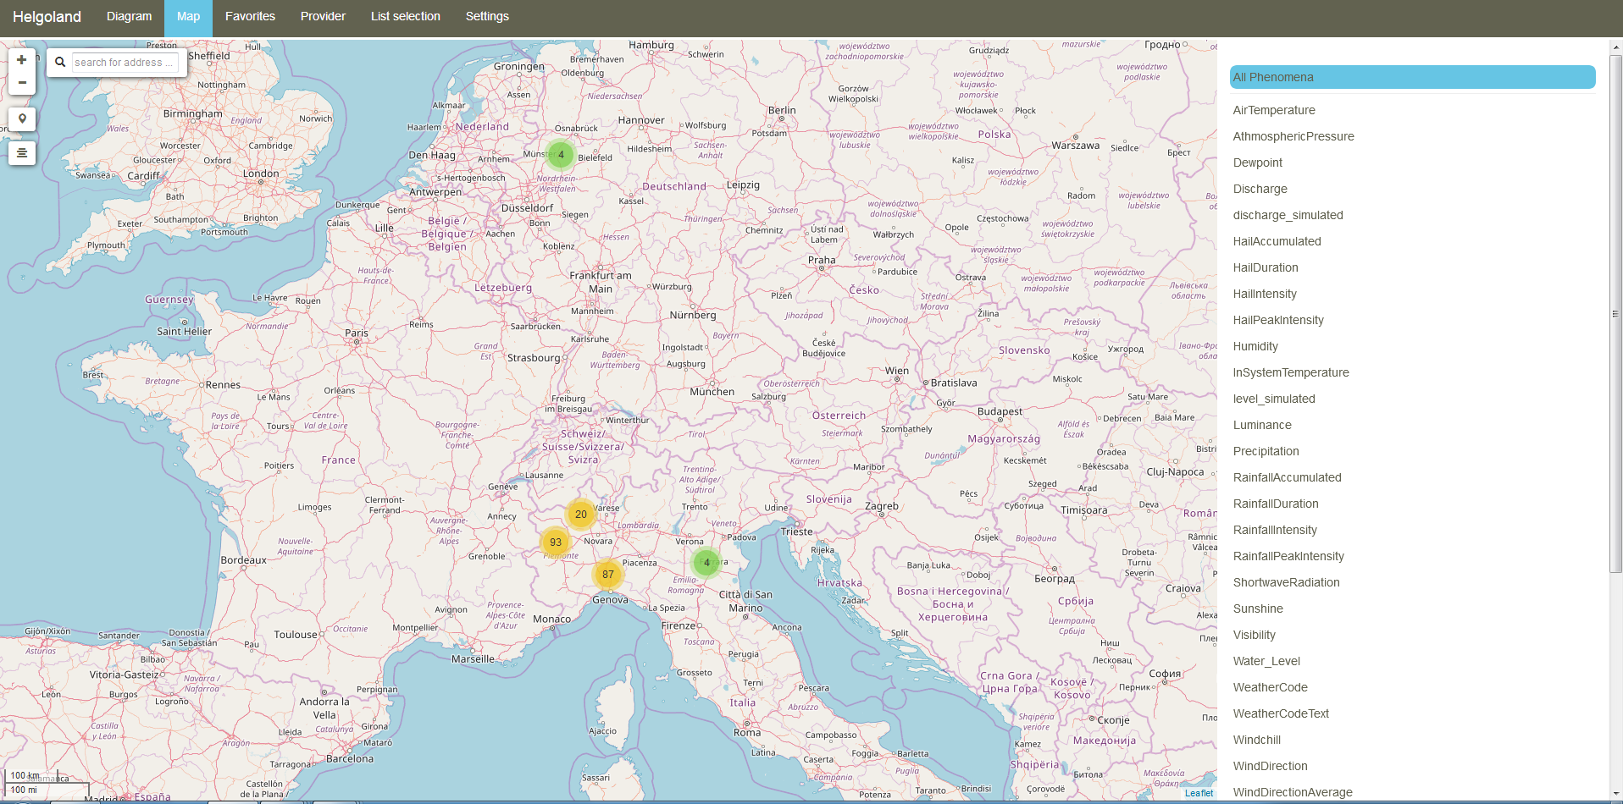
Data and information harmonization and interoperability
52North Helgoland -> Broker -> Hydrology data
Protocol under test: OGC Sensor Observing Service v. 2.0

Slide 9
Data and information harmonization and interoperability
52North Helgoland -> Broker -> Hydrology data
Protocol under test: OGC Sensor Observing Service v. 2.0

Slide 10
Next Steps
Tests with 52 North SOS clients (done)
SWE client
Helgoland
Tests and integration in EMODnet Physics
Tests with additional NRT marine sources
Publishing CUAHSI WOF services
Publishing other protocols (e.g. OGC SOS, THREDDS/OPeNDAP)

